Slide 1
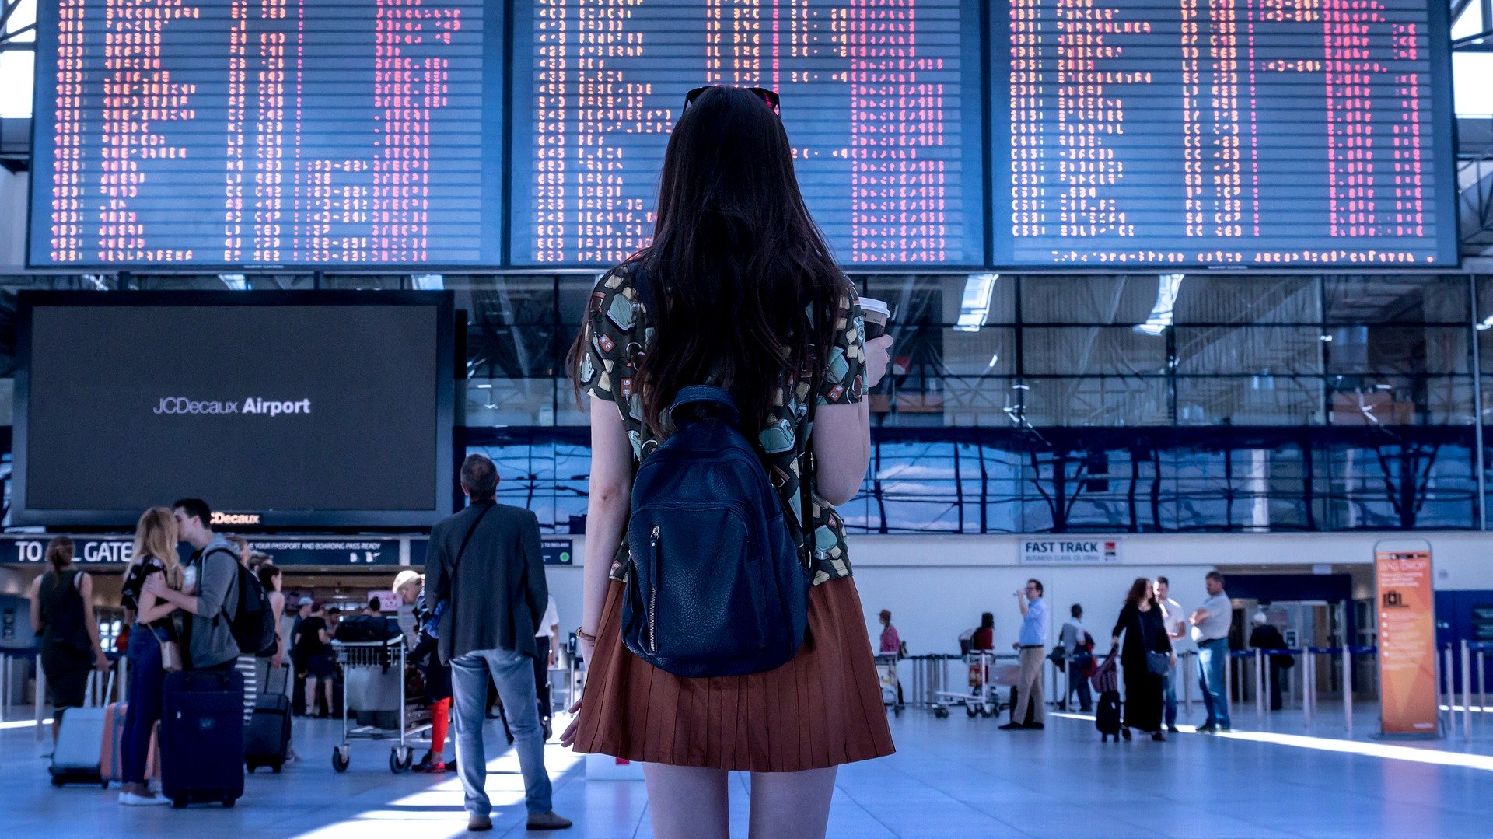
Optimizing flight choices for punctuality
Binh Hoang

Slide 2
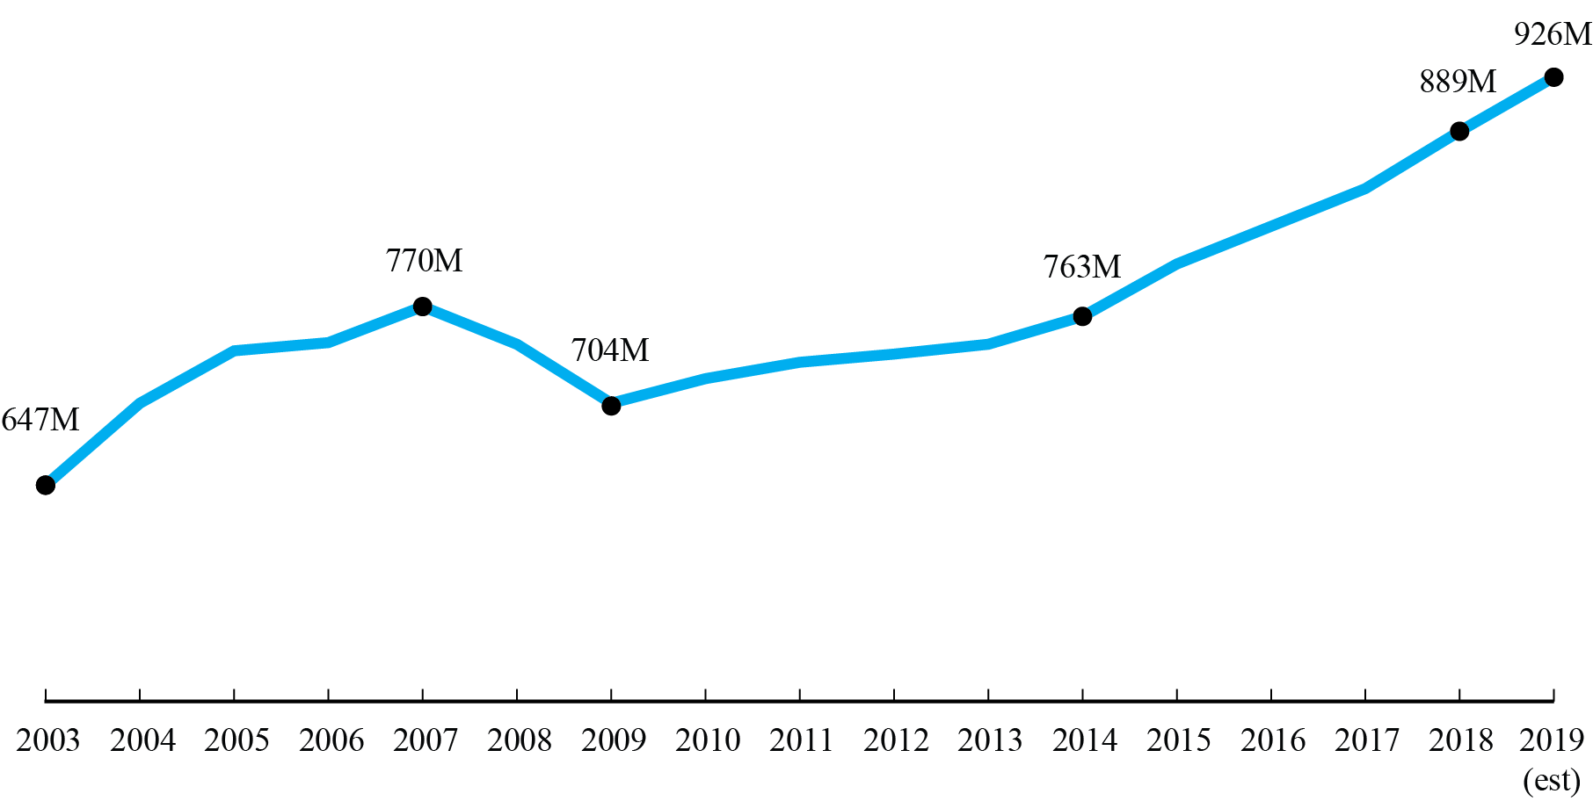
Tremendous growth in domestic air travel
Source: Bureau of Transportation Statistics

Slide 3
Goals
Build classification model to understand domestic flight delays
Suggest tips for travelers looking to optimize their flight choices for punctuality
saving time = saving $
Notes:
Y’all should walk away with some practical travel tips/things to keep in mind when you choose your next flight

Slide 4

Methodology
Data: Kaggle 2015 U.S. flights (100k flights subset), Visual Crossing Weather
Tools: SQL, Tableau
Models: logistic regression, random forest, xgboost
Metric: F1 (precision/recall)

Slide 5
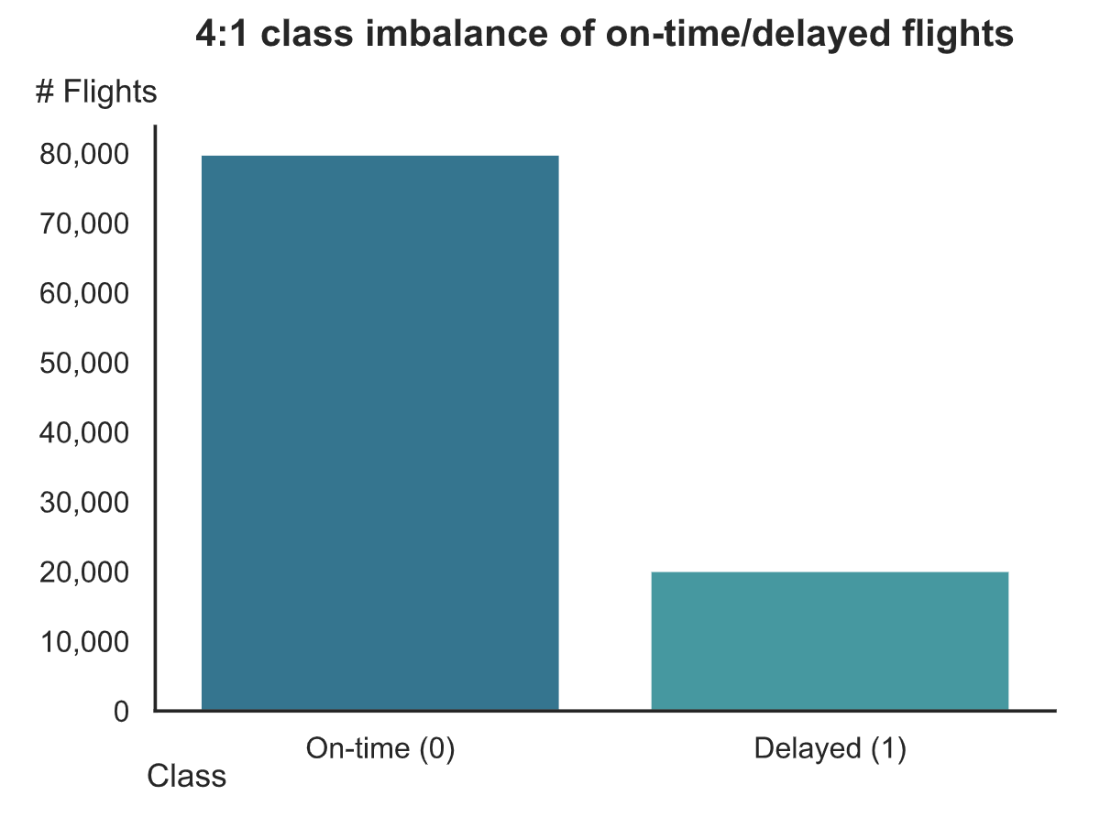
Class imbalance
Strategies:
Balanced class weights
47% threshold (to optimize F1)

Slide 6
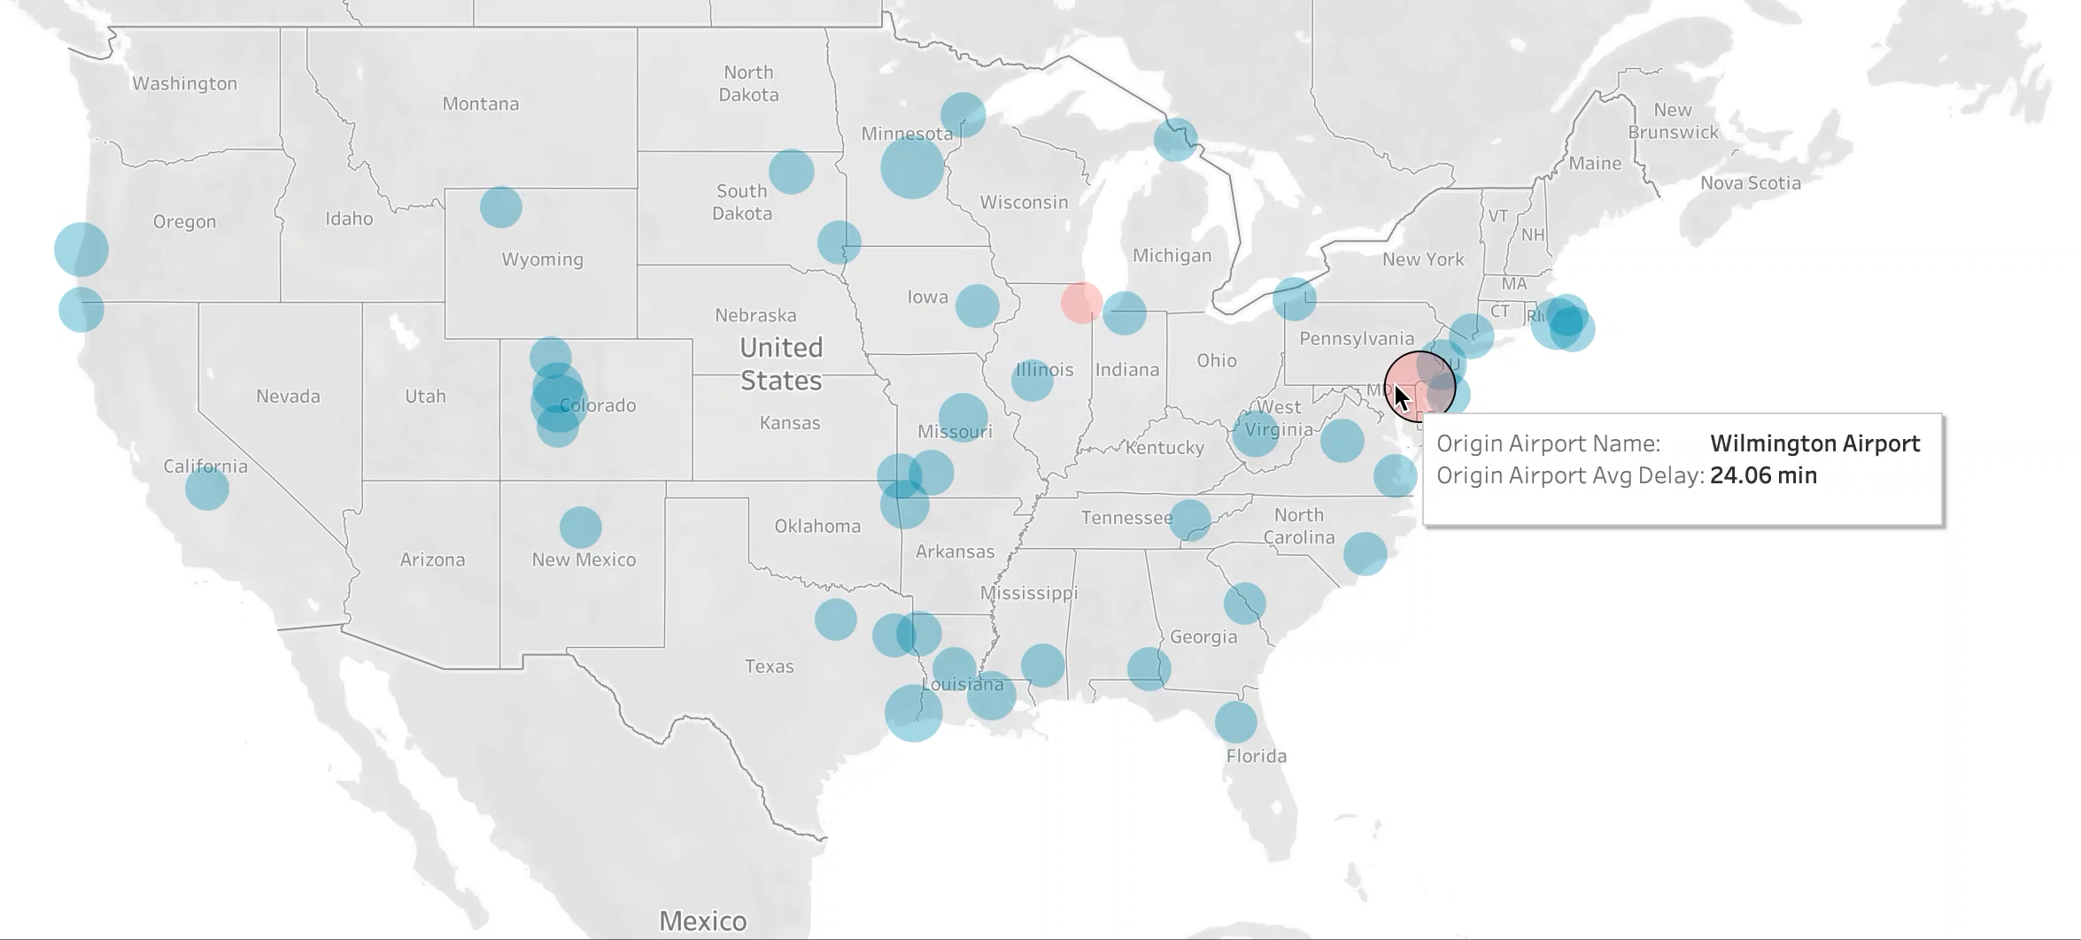
Feature engineering example: origin airport avg arrival delay

Slide 7
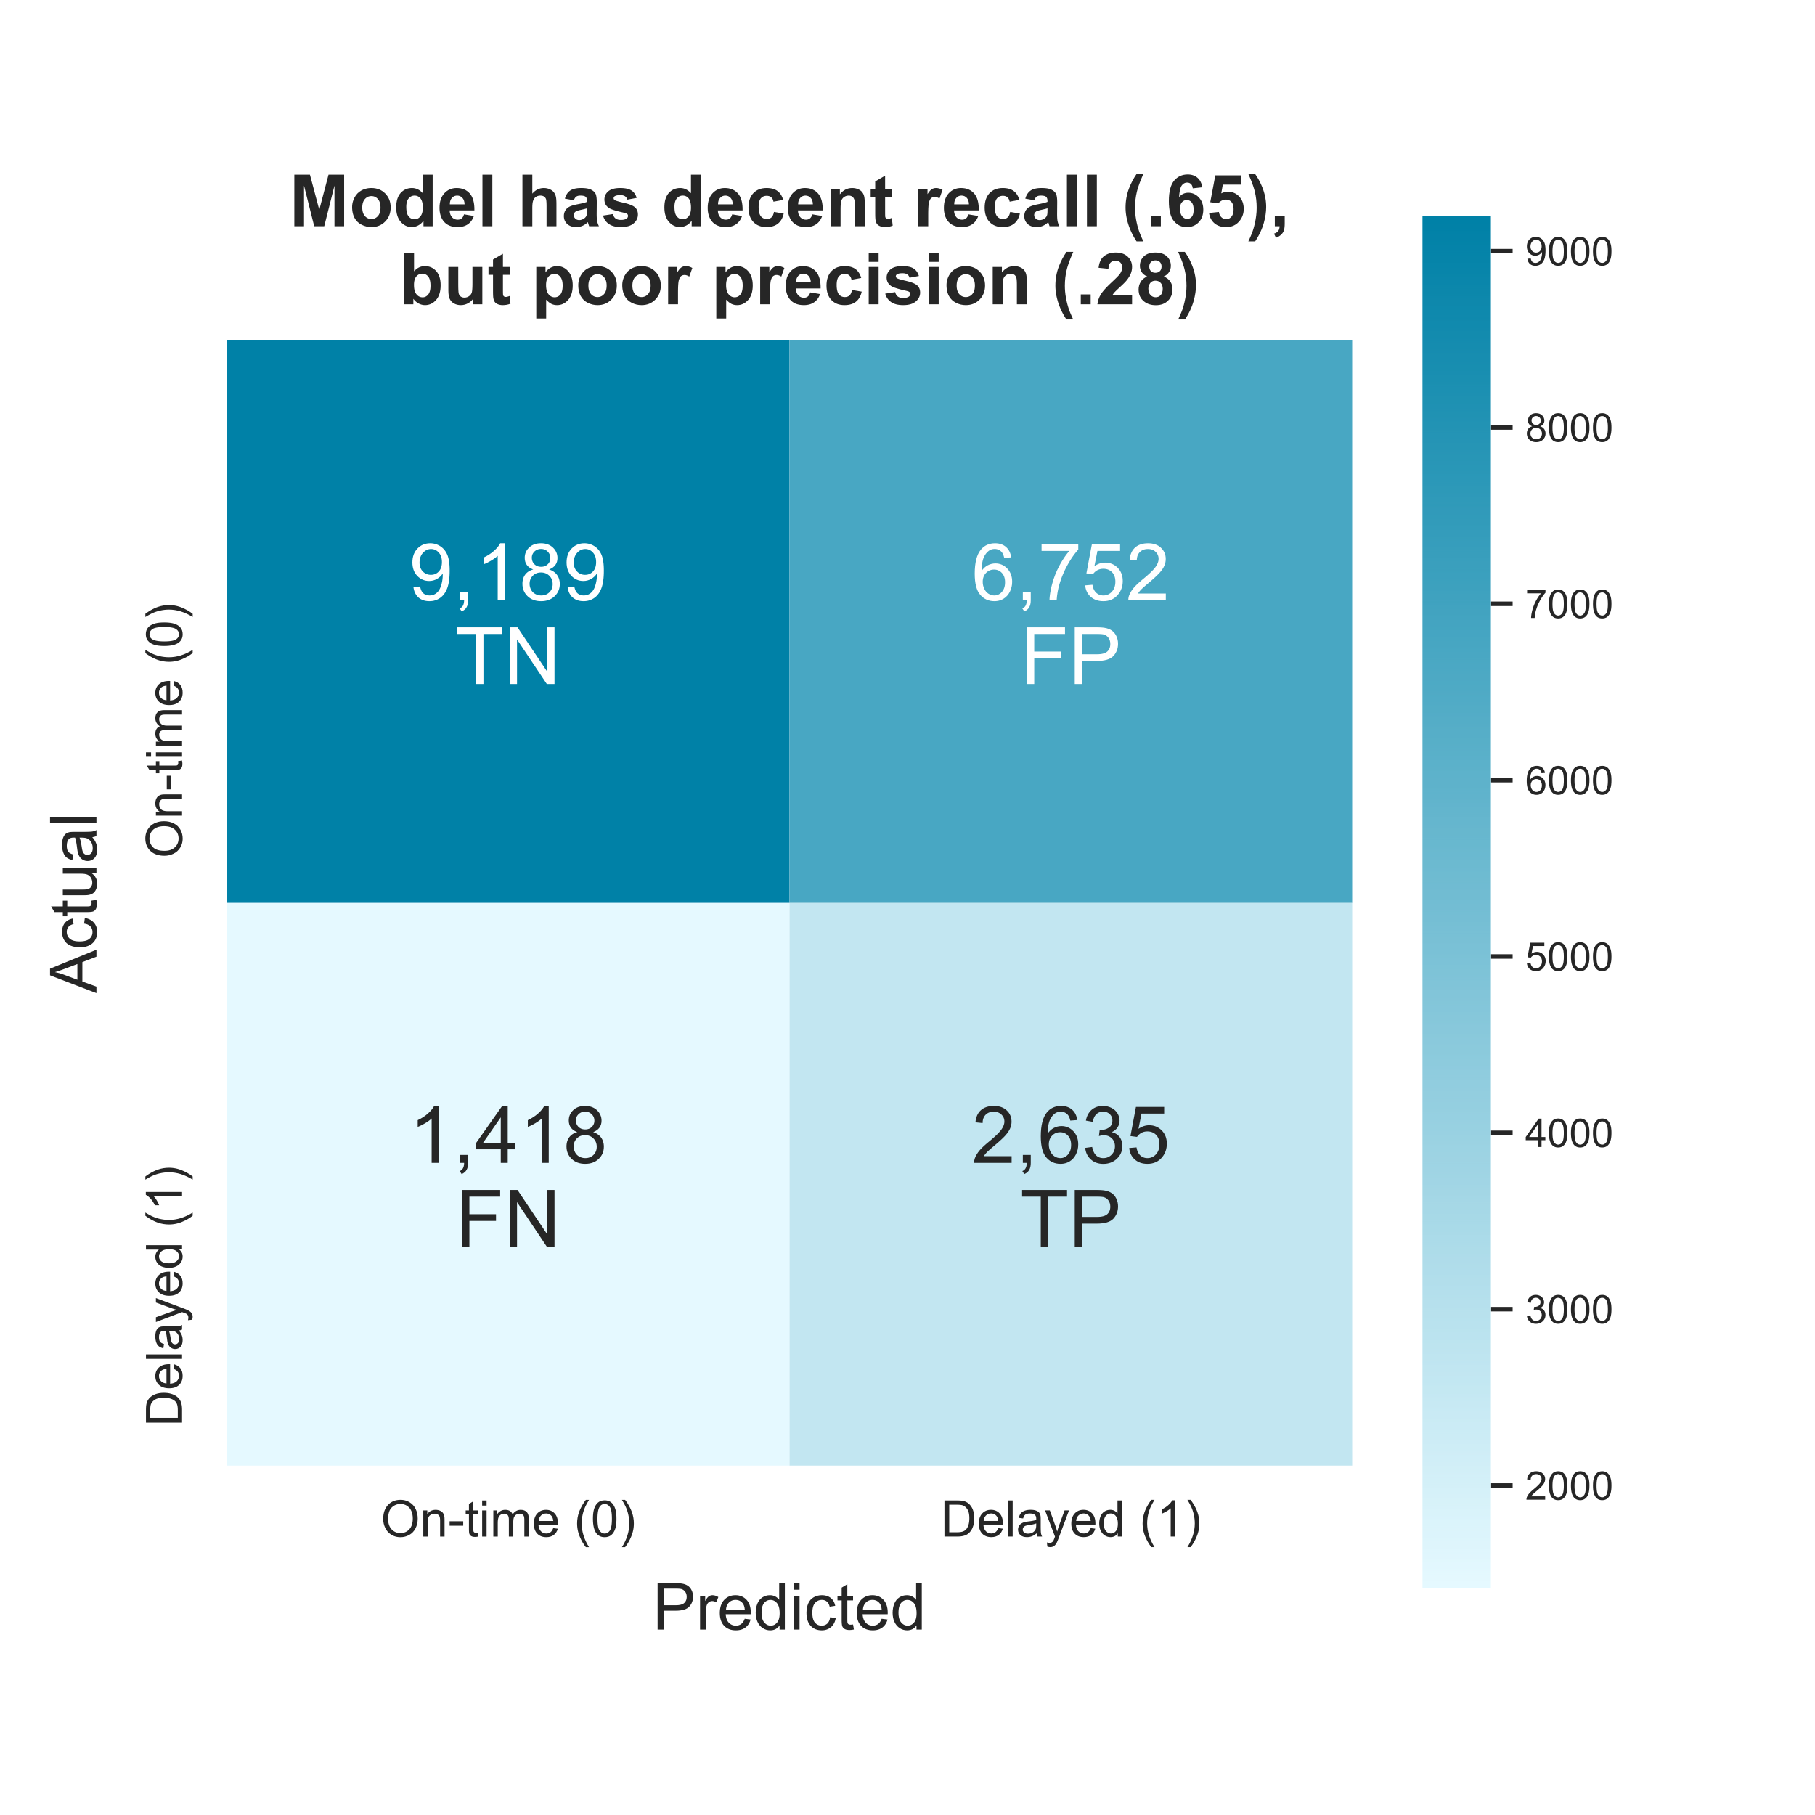
High bias/low variance
 | Train | Test
F1 | 0.40 | 0.39
Precision | 0.28 | 0.28
Recall | 0.66 | 0.65
Notes:
Correlation matrix on test set

Slide 8
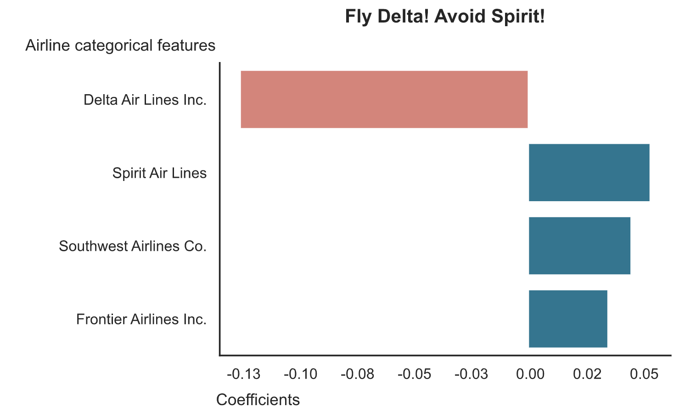
Tip #1

Slide 9
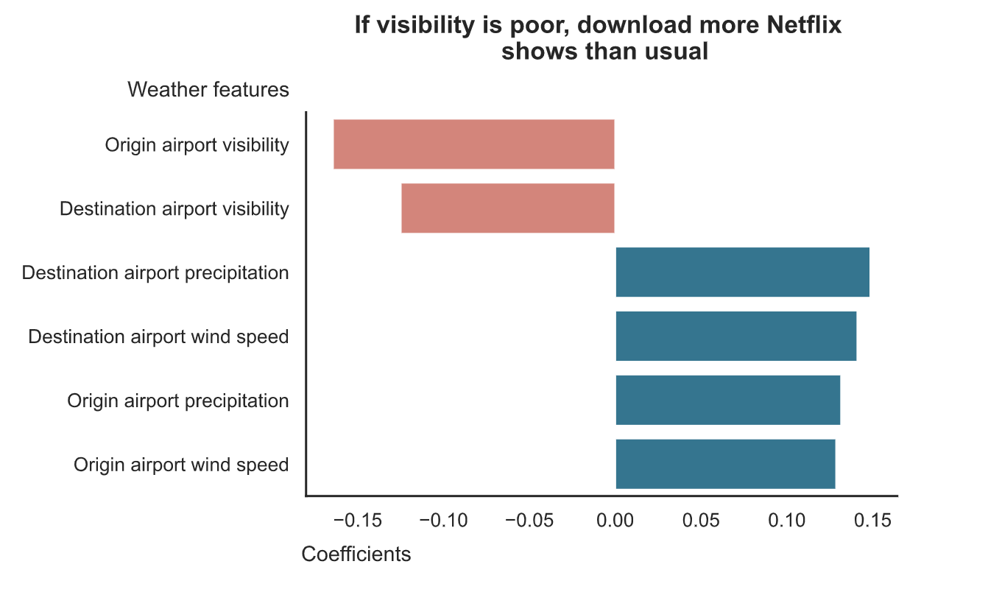
Tip #2

Slide 10
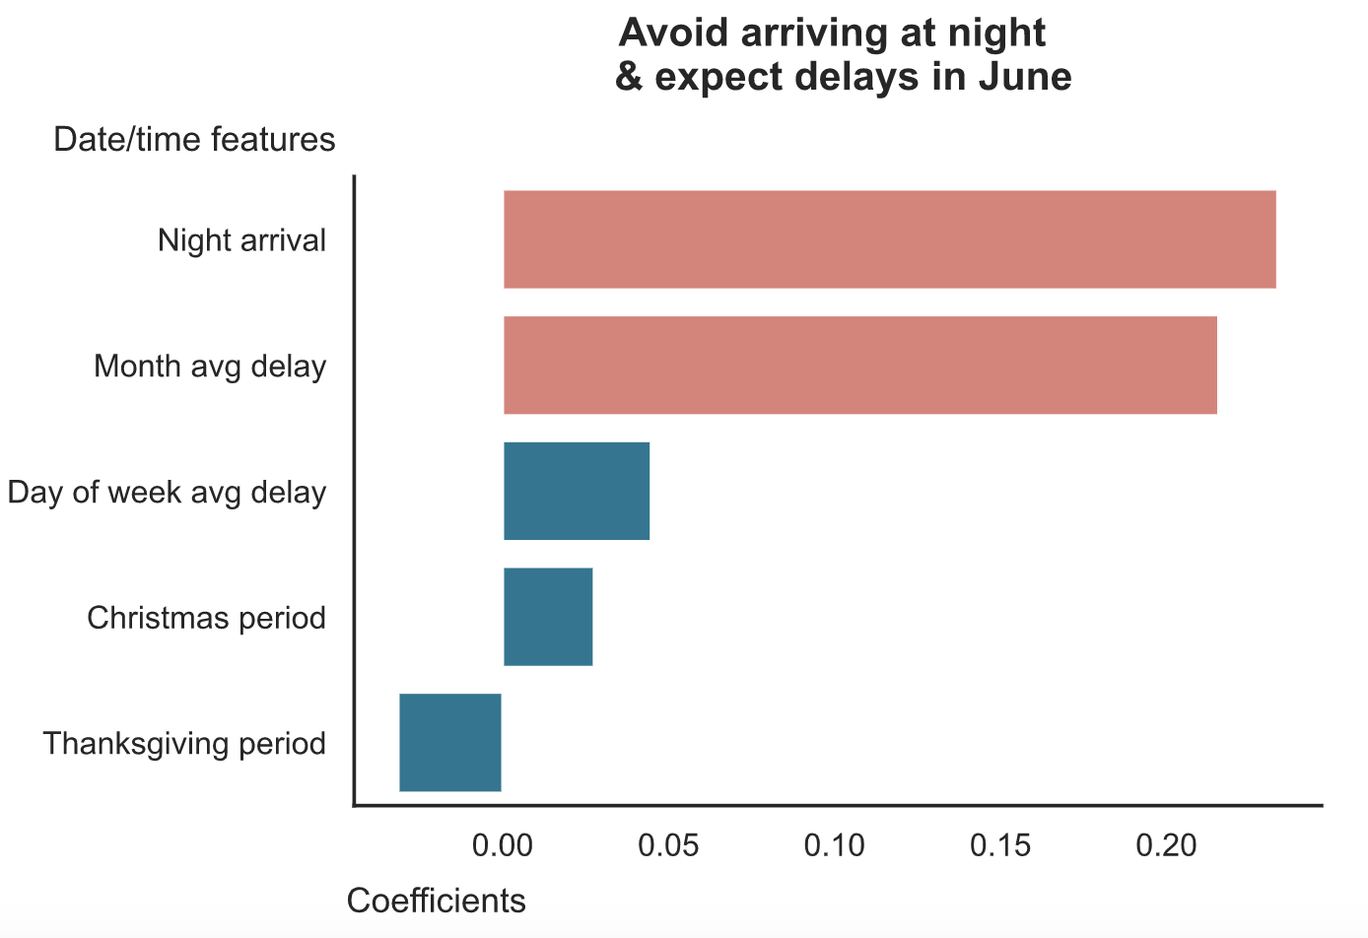
Tips #3/4

Slide 11
Mihashi made bad flight choices
Spirit Air Lines
June
Night arrival
(other features not listed here)
Delay probability:
73% – oh no!
Mihashi from Ookiku Furikabutte

Slide 12
Let’s do a flight makeover!
Spirit –> Delta
June –> May
Night arrival –> Day arrival
(other features not listed here)
Delay probability:
42% – much better!
Mihashi from Ookiku Furikabutte

Slide 13
Conclusion
Do:
Fly Delta
If visibility is low, download more Netflix shows than usual
Don’t:
Fly Spirit
Fly in June
Fly at night
Fly from Chicago O’Hare/Wilmington, DE

Slide 14
Future work
Scale up using Google Cloud
Improve F1 through additional feature engineering/modeling
Create Flask for users to get flight delay probabilities from logistic model

Slide 15
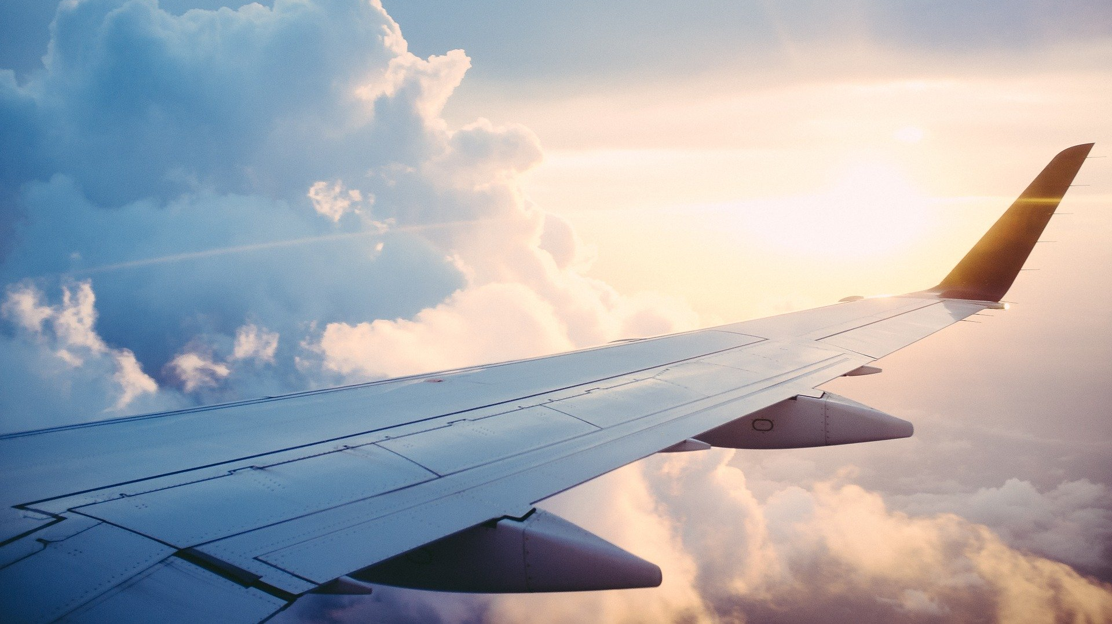
Thank you! Fly safely and on time.

Slide 16
Appendix
Class definitions:
In my code, is_not_on_time is the target where 1 is the positive class and 0 is the negative class.
is_not_on_time = 1 if
Flight is 15 minutes or more later than scheduled arrival time (matches Federal Aviation Administration’s definition of flight delay); in code, where arrival_delay >= 15
Flight is cancelled
Flight is diverted
Else is_not_on_time = 0

Slide 17
Appendix
Filling arrival_delay null values:
arrival_delay is null where where flight was cancelled or diverted
Because I featured engineered avg_arrival_delay at the airline/origin airport/destination airport aggregation level, I want to penalize those airlines/airports that cancel/diverted flights, so I filled arrival_delay null values with the 99th percentile of arrival_delay, which in my dataset was

Slide 18
Appendix
Additional resources to understand flight delays:
Understanding the Reporting of Causes of Flight Delays and Cancellations (https://www.bts.gov/topics/airlines-and-airports/understanding-reporting-causes-flight-delays-and-cancellations)
Why There Are So Many Flight Delays in the Summertime (https://lifehacker.com/why-there-are-so-many-flight-delays-in-the-summertime-1796465726)
Why You Should Never Fly at Night on These 30 Airlines (https://www.smartertravel.com/airlines-to-never-fly-night/)

